Slide 1

Earth Science Department
Master’s degree in Exploration and Applied Geophysics
Salt Body Segmentation in Seismic Imaging using Semi-Supervised Learning
Professor:
Nicola Bienati
Student:
Diego Eustachio Farchione
A.Y. 2021/2022

Slide 2
Introduction
One of the major challenges of seismic imaging is the localization and delineation of subsurface salt bodies. The precise location of salt deposits helps to identify reservoirs of hydrocarbons, such as crude oil or natural gas.
Imaging salt has been a huge topic in the seismic industry, and The Society of Exploration Geophysicist (SEG) alone has over 10,000 publications with the keyword salt. Salt bodies are crucial for the hydrocarbon industry, since the precise location of salt deposits helps to identify reservoirs of hydrocarbons, such as crude oil or natural gas.
However, this task is notoriously difficult due to the complex shapes of steeply dipping flanks, adjacent overburden strata, and the usually strong acoustic impedance and velocity contrasts at the sediment-evaporite interface.
For this purpose, TGS, a leading energy data company which built over time a big seismic data library, set a competition based on the localization of salt bodies.

Slide 3
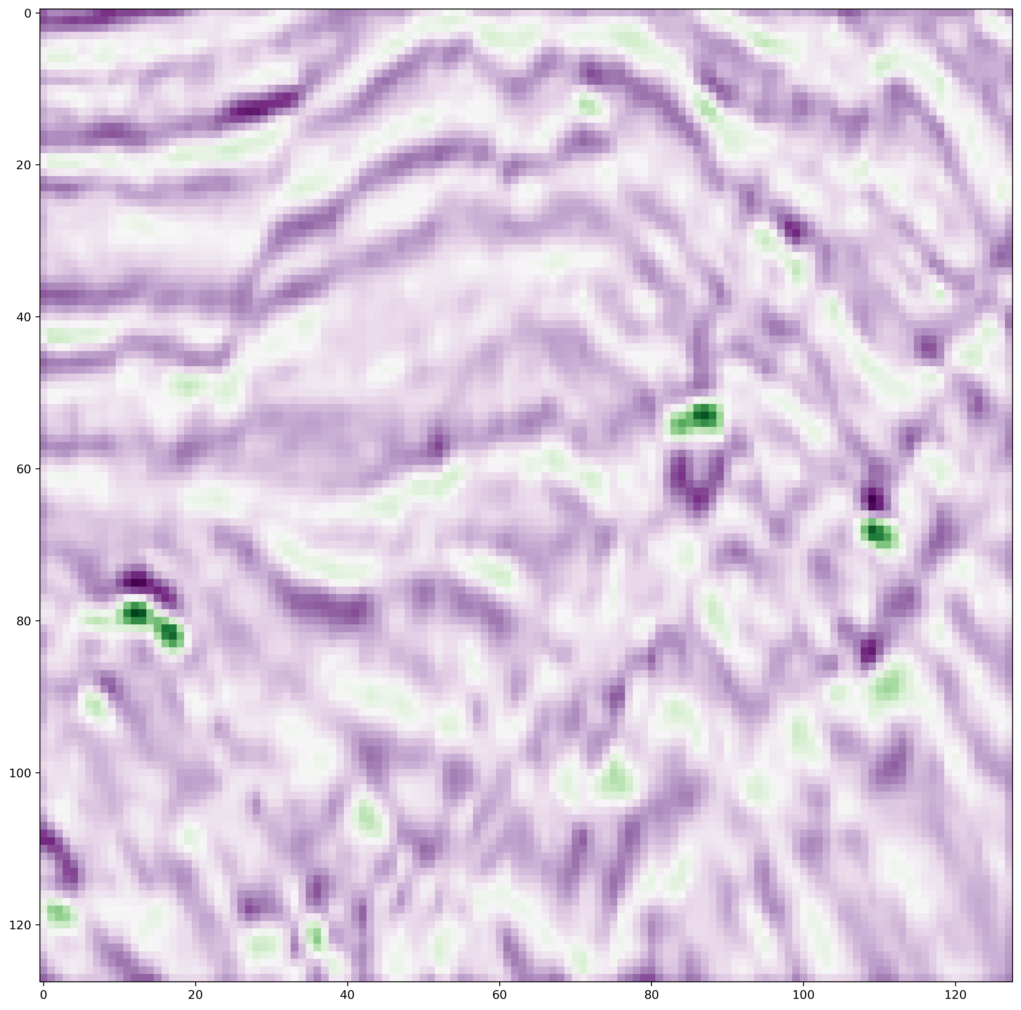
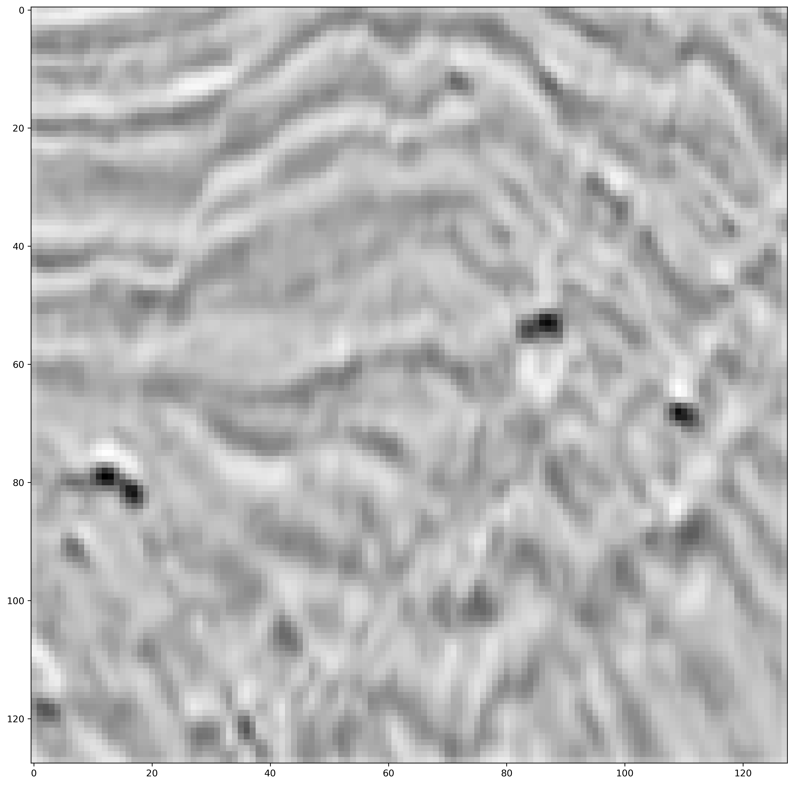
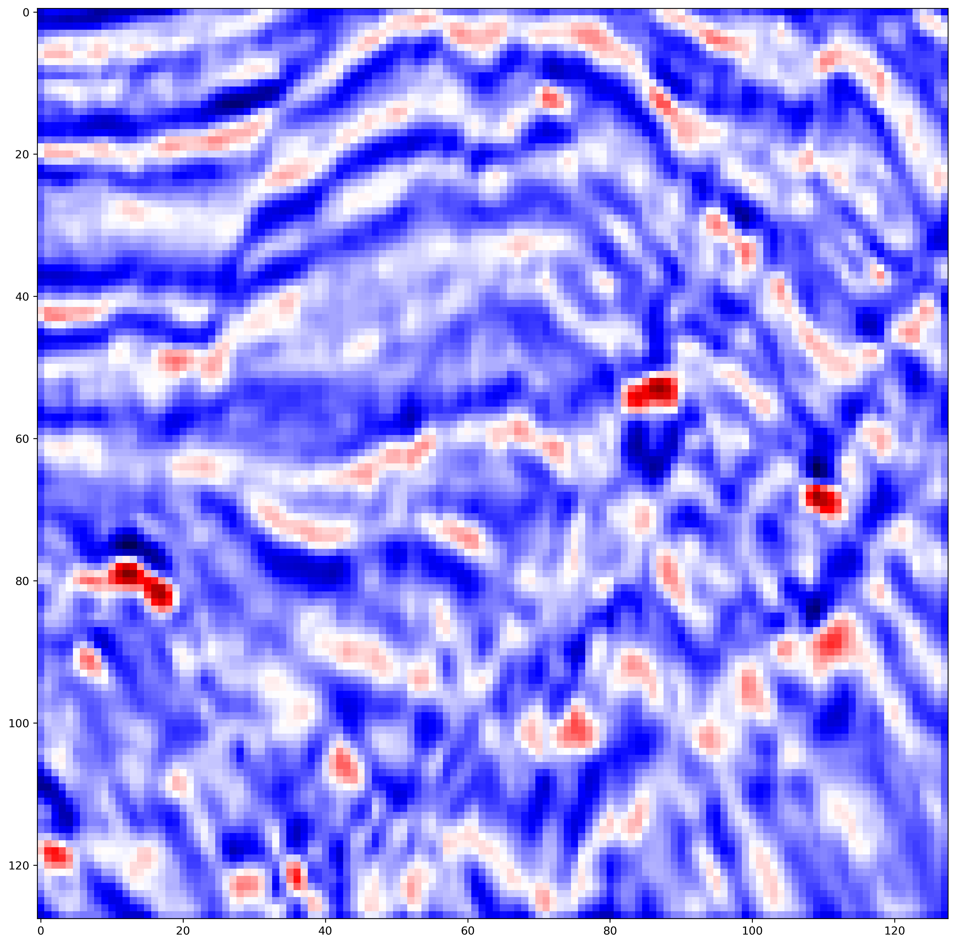
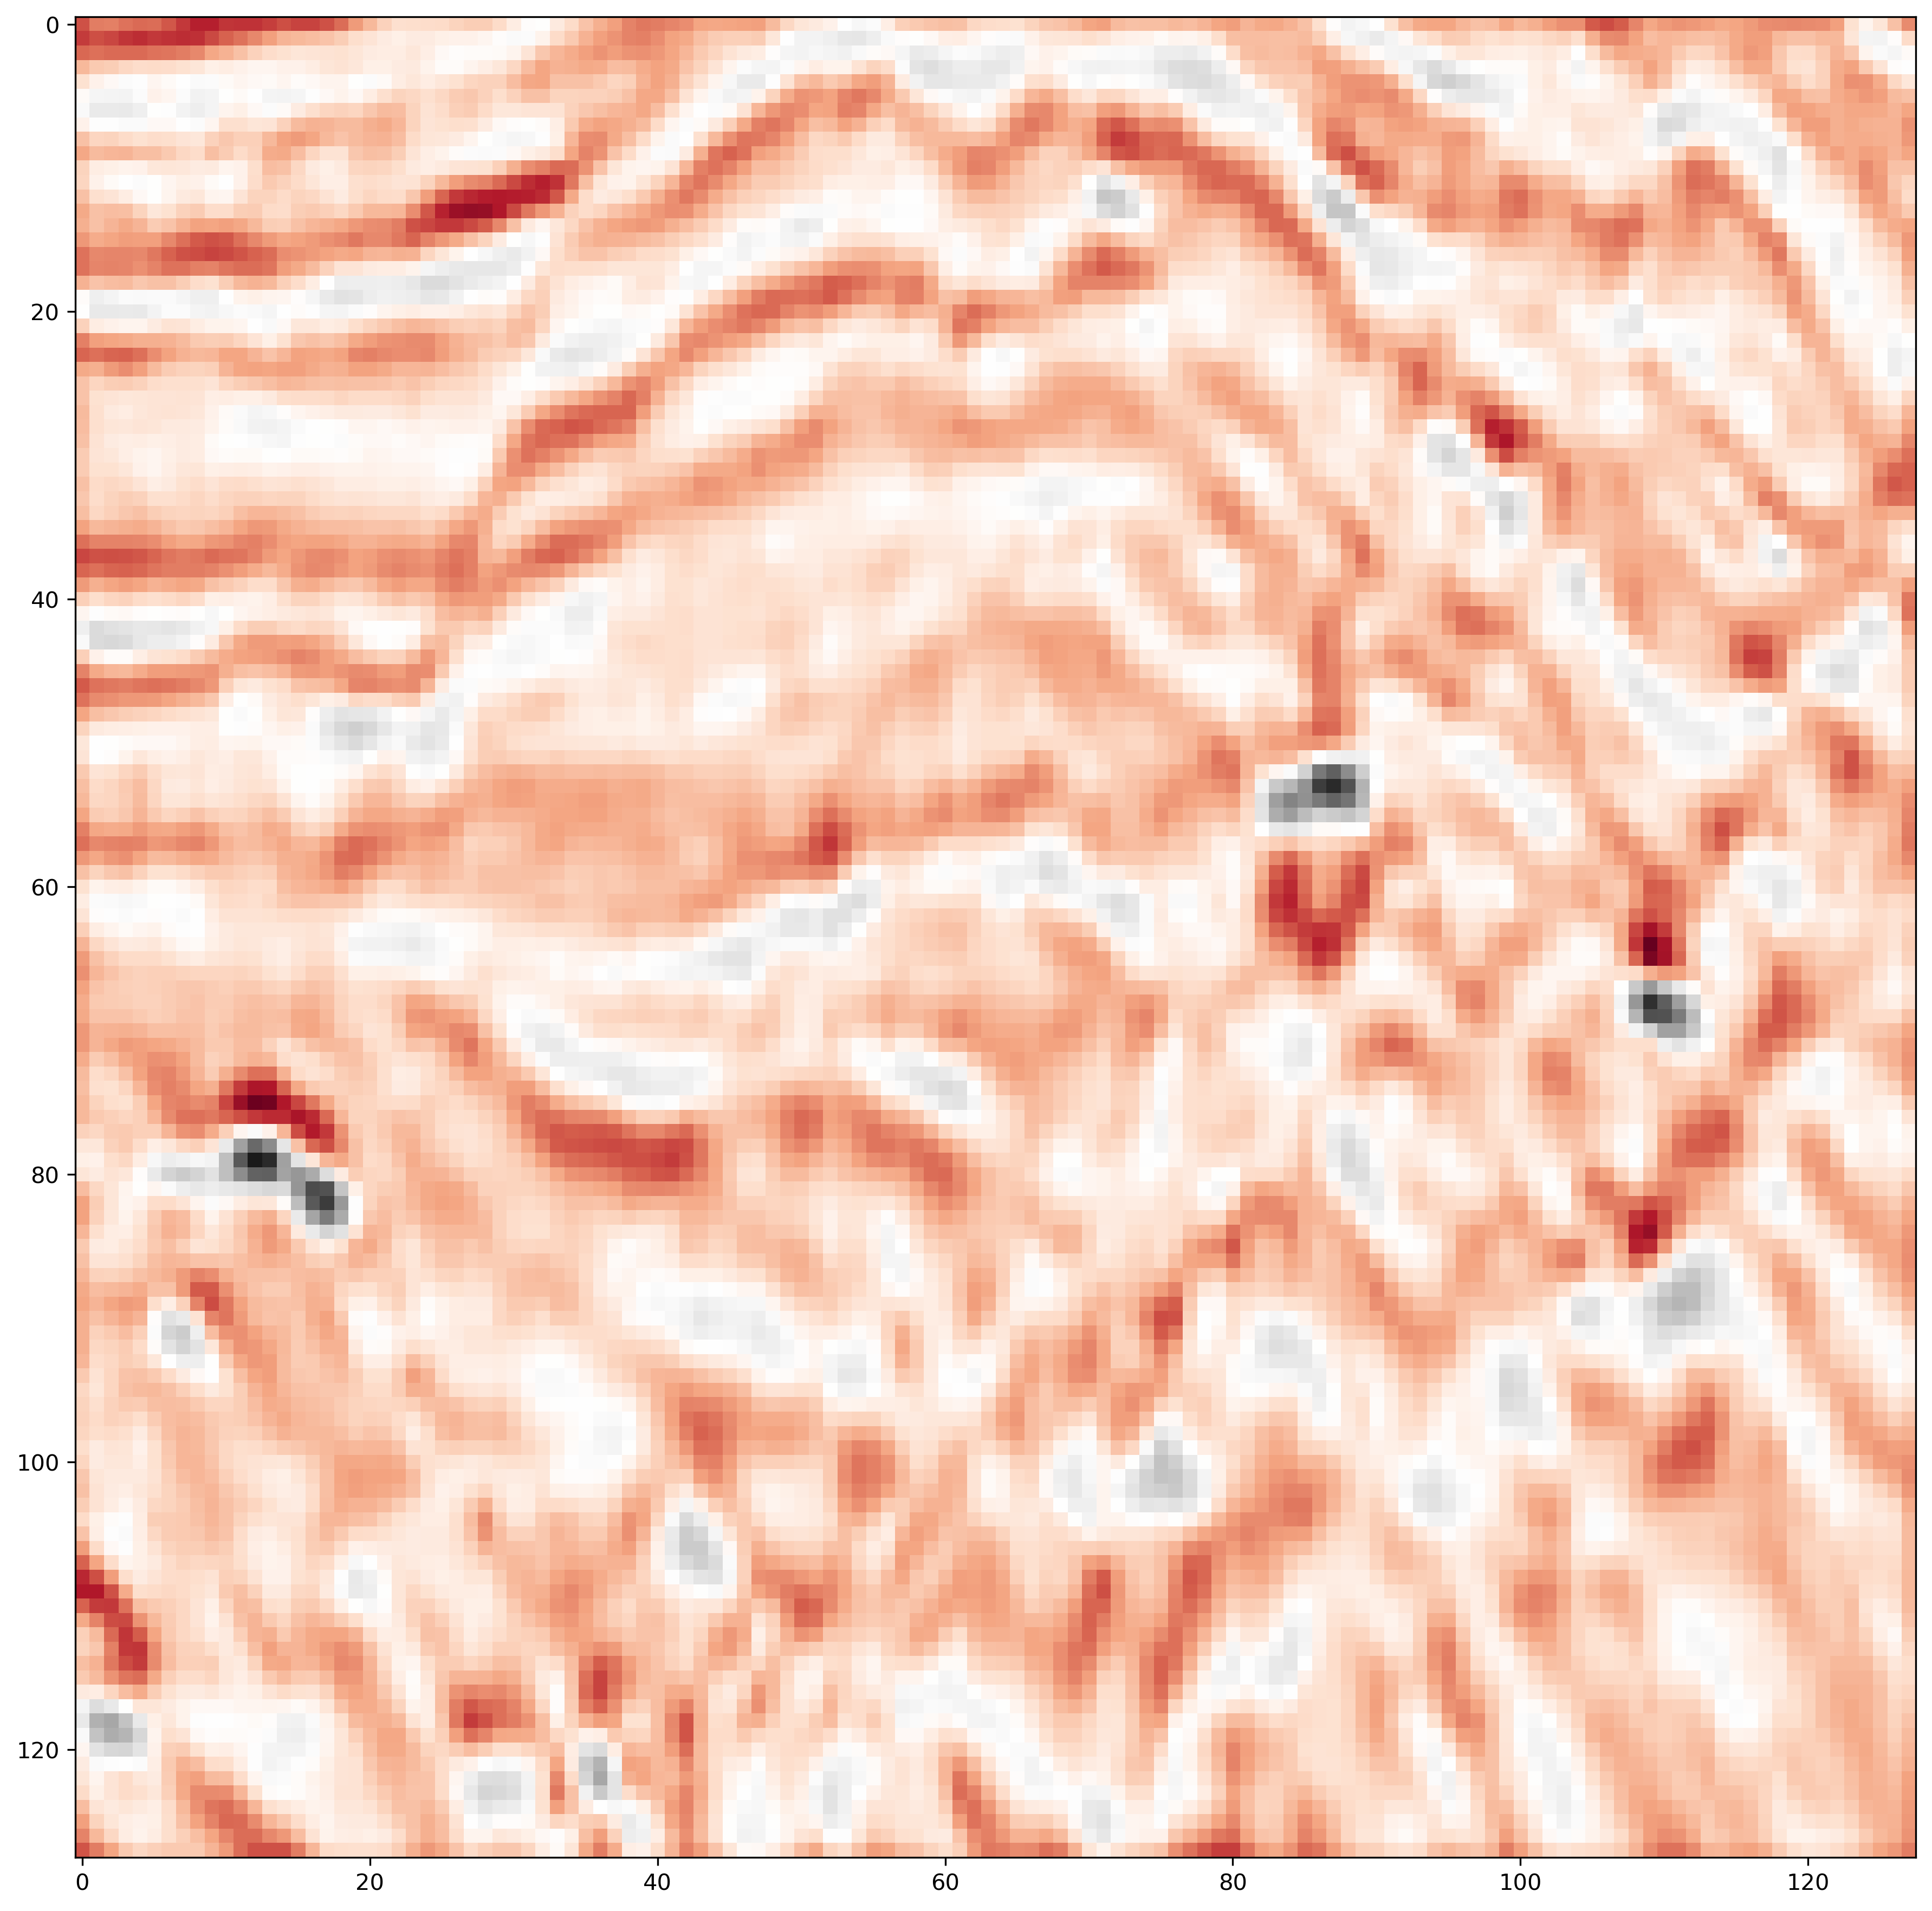
The TGS Competition and its aim
The data for this competition represents 2D image slices of 3D view of earth’s interior. They were collected using reflection seismology.
Thus, input data are a set of single-channel grayscale of seismic sections, and each pixel contains the amplitude of the wave reflection.
Moreover, TGS provided some these seismic sections as PNG files, instead of SEG-Y file that is one of the standard formats for geophysical data.
For the competition purposes, large-size images were transformed into 101×101 pixels.
The whole dataset has been split into two parts: train and test dataset. The train dataset consists of 4000 images together with the predicted outputs, and it is used for developing the predictive model.
The test dataset, instead, contains 18000 unlabeled images.
Hence, the goal of the competition is to localize the regions in the images that contain salt bodies. This can be done using semantic segmentation.
Fig 1. The same seismic section represented with different color scales using Python.

Slide 4
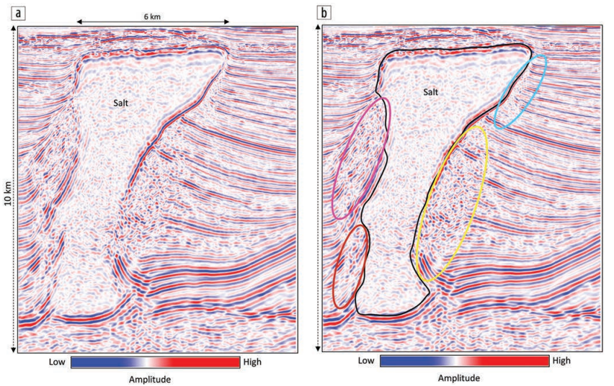
Introduction
The advent of Convolutional Neural Networks (CNNs), a machine learning architecture, brought significant advancements in different problems and several attempts have been made to apply CNNs in the field of seismic imaging. CNNs overcome the need for manual feature design and show superior performance on the tasks of the salt body delineation compared to the methods based on the handcrafted features.
Fig 2. Segment of a seismic depth section (a) without and (b) with interpretation from the Thunderhorse area in the Gulf of Mexico showing a massive salt dome. The boundary of the dome is well-defined on the right, but on the left all we see are the abutting reflections. Low-amplitude chaotic reflections characterize the interior of the salt dome, while the poorly imaged chaotic reflectors outside the salt dome exhibit higher amplitude. Satinder Chopra and Kurt J. Marfurt. Understanding the seismic disorder attribute and its applications. Interpreter’s Corner - Coordinated by Ezequiel Gonzalez. August 2016.

Slide 5
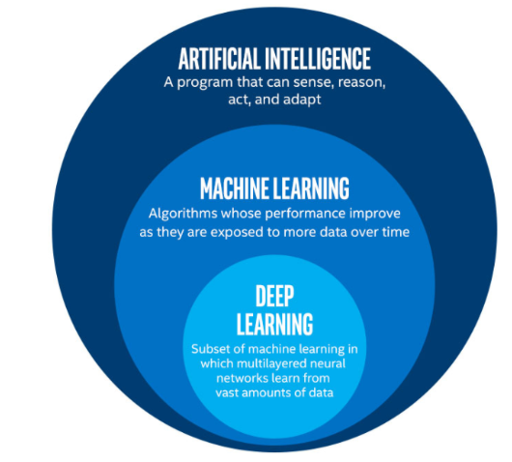
Some important definitions
Machine Learning
In 1959, Arthur Samuel defined machine learning as a “Field of study that gives computers the ability to learn without being explicitly programmed”.
It’s a branch of artificial intelligence which focuses on the use of data and algorithms to imitate the way that humans learn, gradually improving its accuracy.
Deep Learning
Deep learning is a subset of machine learning, which uses neural networks with three or more layers to learn pattern from data. These neural networks attempt to simulate the behavior of the human brain, allowing them to “learn” from large amounts of data.
Supervised Learning
It’s a type of machine learning where a computer algorithm is trained on input data that has been labeled for a particular output. The model is trained until it can detect the underlying patterns and relationships between the input data and the output labels, enabling it to yield accurate labeling results when presented with never-before-seen data.
Fig 3. Artificial intelligence, Machine Learning and Deep Learning description.

Slide 6
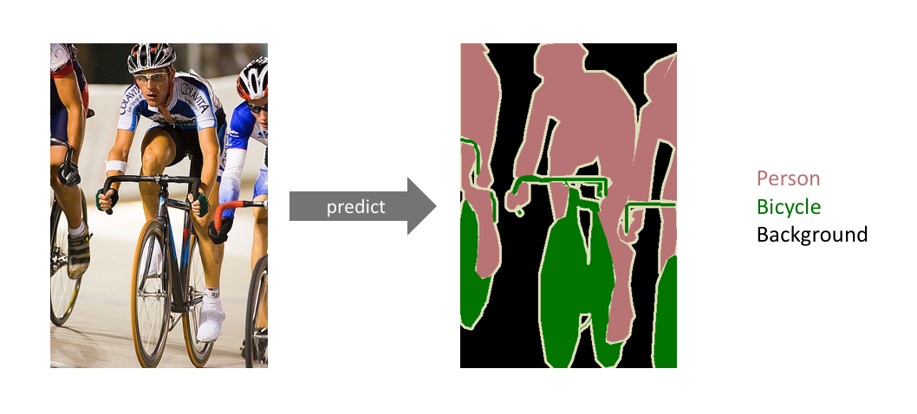
Semantic Segmentation
Semantic segmentation, or image segmentation is the task of clustering parts of an image which belong to the same object class. It is a form of pixel-level prediction because each pixel in an image is classified according to a category.
In this case, we want to predict the pixels in the seismic sections that contain salt bodies.
Therefore, we have as input the seismic sections, and as output, all the pixels with the predictions (also called masks).
If the output image contains values of ‘0’ in the pixels, it indicates that we don’t have salt bodies. On the contrary, a value of ‘1’ means that salt bodies are present in that region.
Here, we can observe two examples of semantic segmentation: on the bottom left corner, one with multiple classes (person, bicycle, background), and on the bottom right, the seismic sections with only two classes (background and salt bodies).
Fig 4. An example of 3-classes image segmentation.
Fig 5. Salt body segmentation on TGS seismic sections.

Slide 7
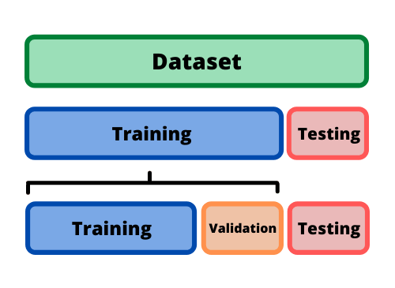
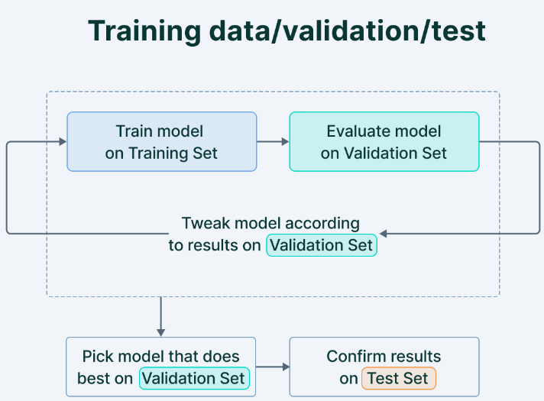
Train-validation-test dataset split
Train dataset (3600 images)
It is used to train and make the model learn the hidden patterns in the data.
The training set should have a diversified set of inputs so that the model is trained in all scenarios and can predict any unseen data sample that may appear in the future.
Validation dataset (400 images)
The validation set is a set of data that is used to validate our model performance during training.
This validation process gives information that helps us adjust the model’s architecture and configurations accordingly. The model is trained on the training set, and, simultaneously, the model evaluation is performed on the validation set.
The main idea of splitting the dataset into a validation set is to prevent our model from overfitting (the model becomes excellent at classifying the samples in the training set but cannot generalize and make accurate classifications on the data it has not seen before).
Test Dataset (16000 images)
The test set is used to test the model after completing the training.
It provides an unbiased final model performance metric in terms of predictions.
Fig 6. Train, validation, test dataset split.
Fig 7. Train, validation and test dataset: training,evaluation and prediction.

Slide 8
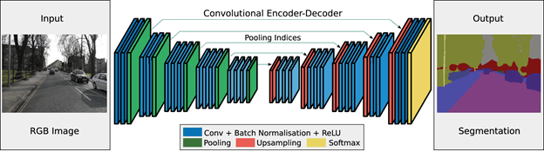
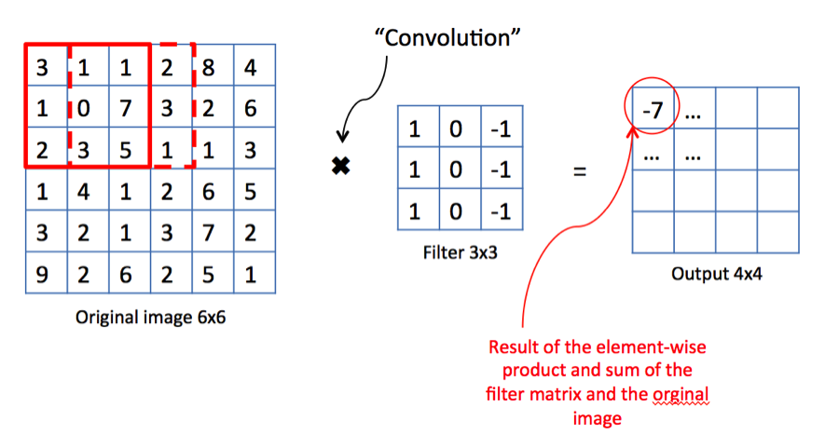
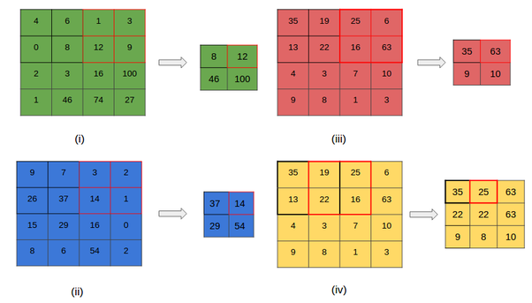
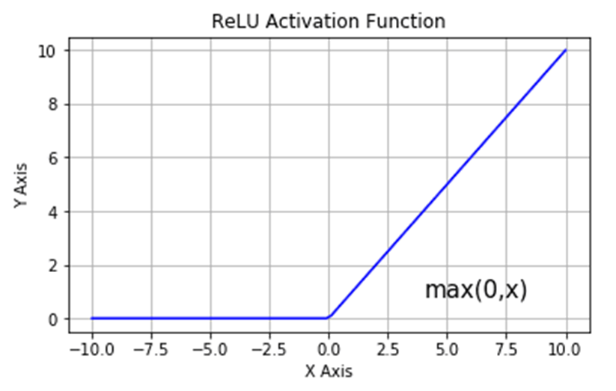
Convolutional Neural Networks for image segmentation
Fig 8. An example of a Convolutional Neural Network for image segmentation.
Convolutional Layer
Max Pooling Layer
Activation Function
Fig 9. Convolutional layer in a CNN.
Fig 10. Max Pooling layer in a CNN.
Fig 11. Example of an activation function.

Slide 9
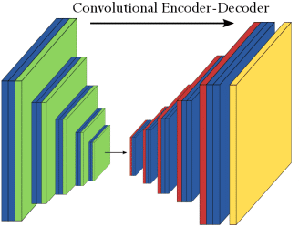
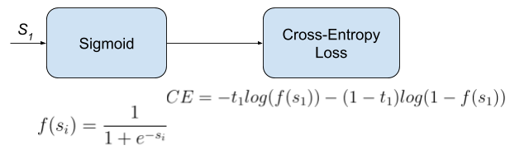
Convolutional Neural Networks Pipeline
Input
(seismic section)
Output
(predictions)
Fig 12. Forward propagation step of a Convolutional Neural Network for seismic segmentation.
Preprocess the images to fit them to the CNN
Weights initialization (Imagenet)
Convolutional and MaxPooling layers
(with ReLU activation function)
Sigmoid activation function
Cross-Entropy Loss calculation
Compute Intersection Over Union metric
Backpropagation (minimization of the loss function)
Salt body prediction
Forward propagation

Slide 10
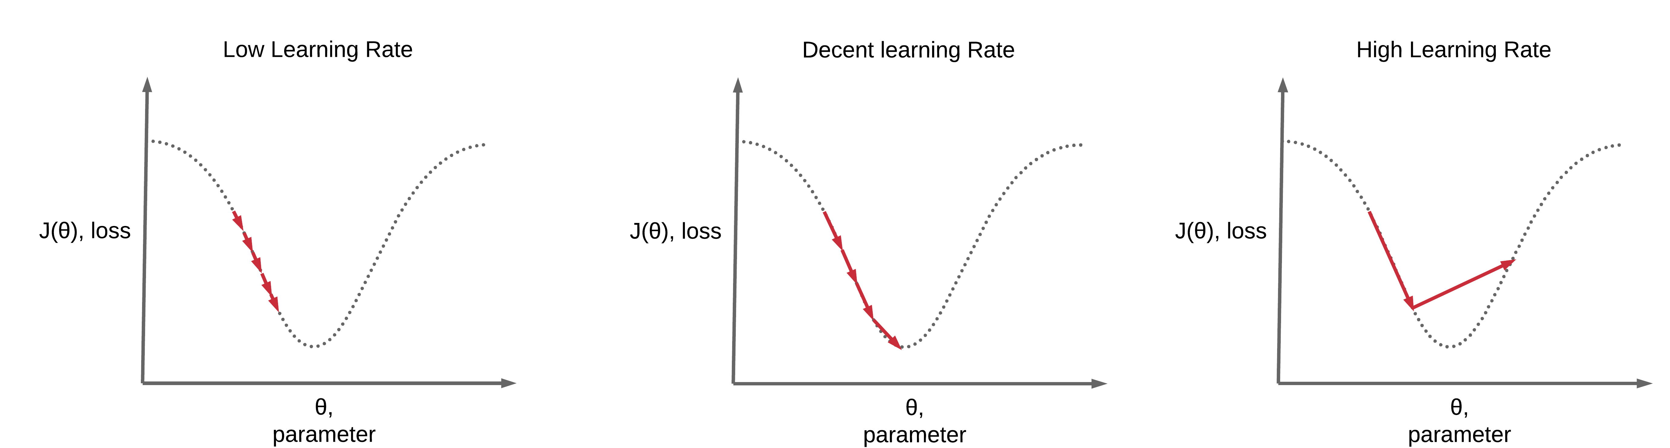

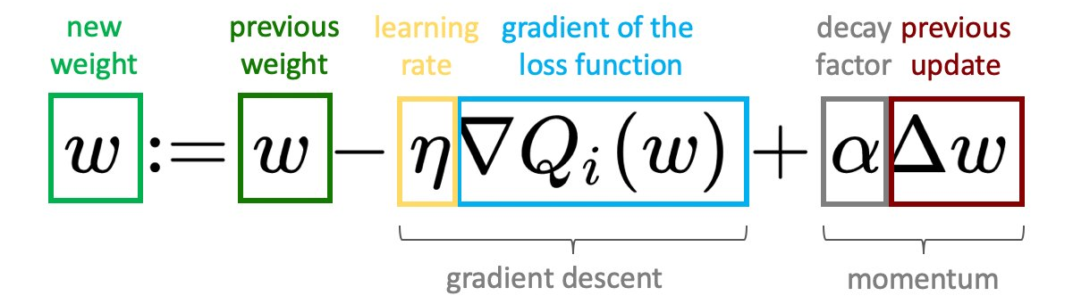
The loss function
The loss function evaluates how well the model predicts the output masks. For this purpose, the loss function is the binary cross-entropy.
If the predictions are totally off, the loss function will output a higher number. For each prediction, the loss function will simply measure the absolute difference between the model prediction and the actual output.
The aim is minimizing the loss function to have values of predicted masks as close as possible to the actual values.
It is possible to obtain it applying backpropagation with gradient descent.
Loss function
weight f
weight f
Fig 13. Brief description of Backpropagation formula and loss function.

Slide 11

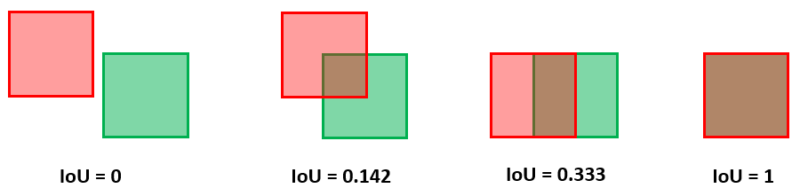
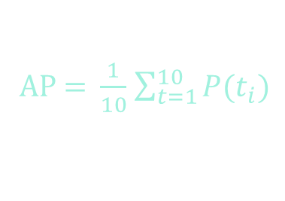

Metric: Intersection Over Union
The metric used for this task is defined as the intersection over union (IoU) The IoU of a predicted set of salt pixels and a set of true salt pixels is calculated as:
$$\frac{\text{A}∩\text{B}}{\text{A}\text{ ∪ }\text{B}}$$
A=predicted
B=actual
$$\text{IoU}\text{(}\text{A}\text{, }\text{B}\text{)}=$$
Fig 15. Intersection over Union: range of values.
Fig 14. Intersection over Union: intuitive scheme.
This formula is applied at 10 different precision thresholds: t = (0.50, 0.55, . . . , 0.95).
Thus, the aim is including only the pixels where the predicted probability of finding a salt body is higher than a specific threshold.
Then, the average precision of a single image is calculated as the mean of the above precision values at each threshold::
AP = $\frac{1}{10}$ $\sum_{t=1}^{10}{P(t_{i})}$
with t = (0.50, 0.55, . . . , 0.95)
Finally, the final evaluation score (mAP) is calculated as the mean taken over the individual average precisions of each image in the test dataset.

Slide 12
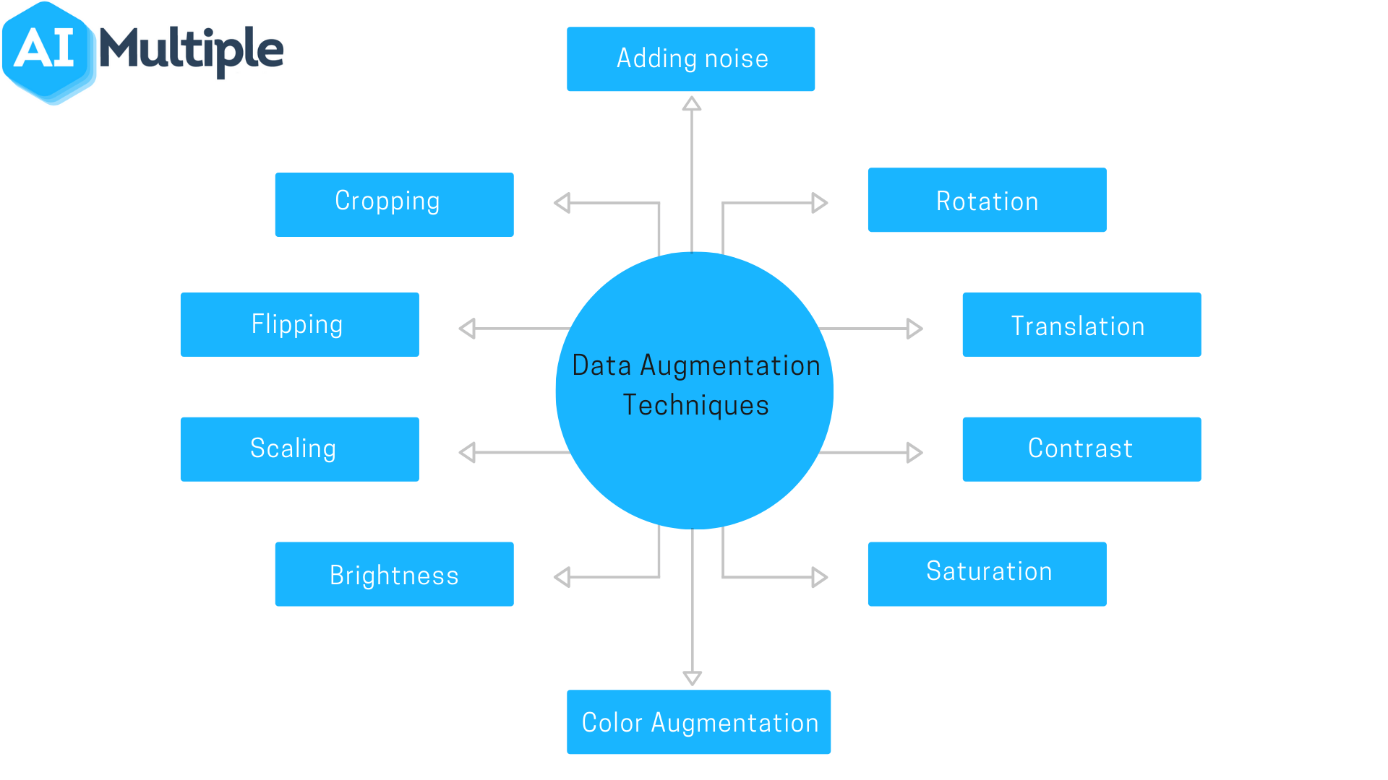
Data Augmentation
Data Augmentation is a technique that can be used to artificially expand the size of a training set by creating modified data from the existing one. It is a good practice to use for two reasons:
To prevent overfitting (when the model contains more parameters than can be justified by the data)
To have a larger dataset ,and thus, improving the performance.
Fig 16. Examples of some data augmentation techniques.

Slide 13
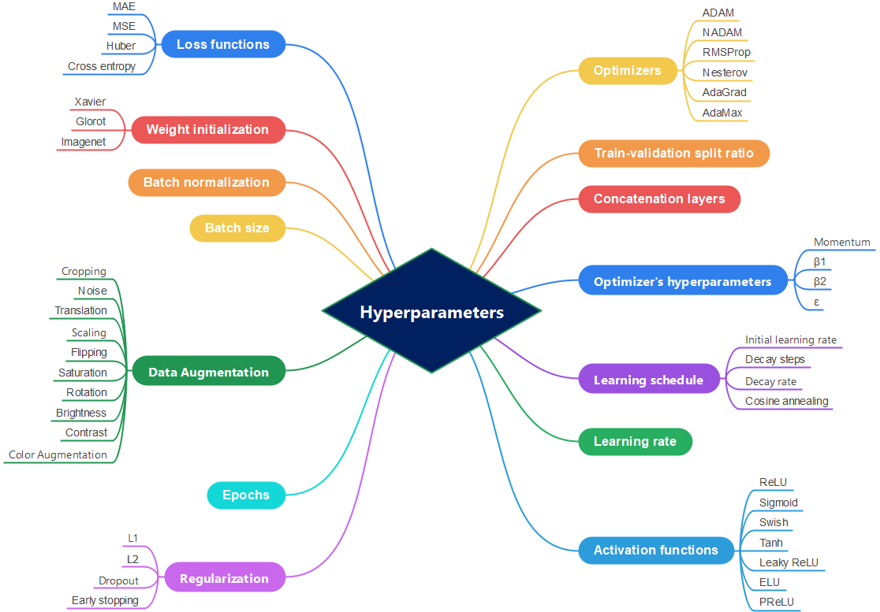

Slide 14
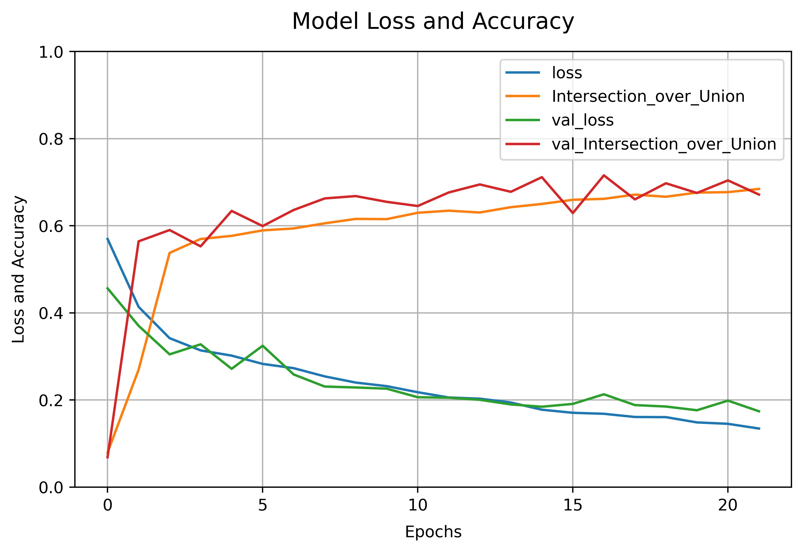
Loss and accuracy scores on train and validation dataset of a CNN
Fig 17. Loss and accuracy scores on train and validation dataset of a CNN. It can be observed that the model is not overfitting (the training and validation loss and accuracy are similar) but the model still have room for improvement.

Slide 15
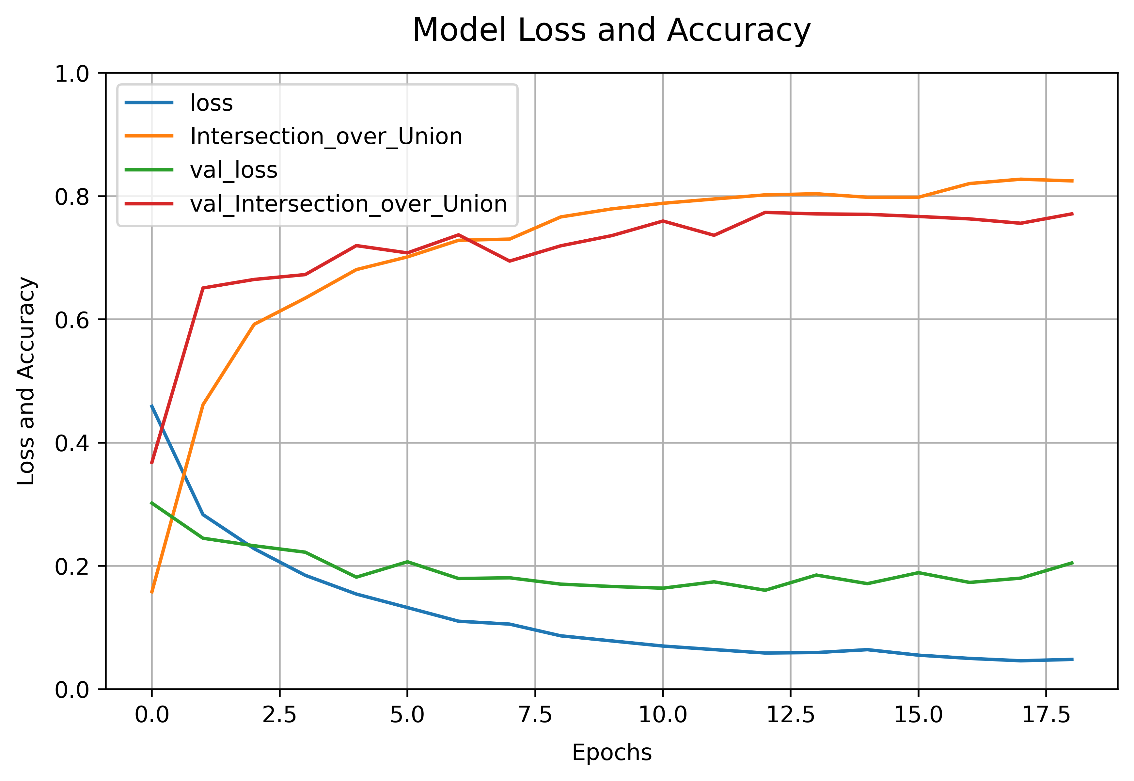
Loss and accuracy scores on train and validation dataset of a Unet + Resnet34 with data augmentation
Fig 18. Loss and accuracy scores on train and validation dataset of a Unet+Resnet34 model. Still, the model is not overfitting and it can be observed that the IoU score is way greater than in the previous case with a simpler CNN.

Slide 16

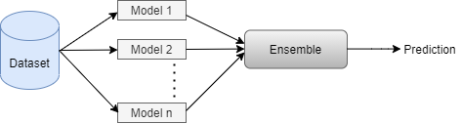
Ensemble Learning
Ensemble learning is an approach to machine learning that seeks better predictive performance by combining the predictions from multiple models (that can also have different architectures).
Stacking, is a way of ‘ensembling’ models. it consists of building an array of models from the same input data. Then, these models are ‘stacked’ using another model (called ‘meta-classifier’), or simply averaging all the predictions.
For this task, fifteen Unet+Resnet34 models were built at the beginning. Among these fifteen models, only the models with an IoU score greater than 0.65 were elected. This was done to avoid that the model gets stuck in a local minimum. Consequently, only eight models overcome this threshold.
These eight models were then ‘stacked’, applying the mean of all these predictions. Thus, the yielded result is more robust and accurate.
Fig 19. A simple scheme that depicts how ensemble learning works.

Slide 17
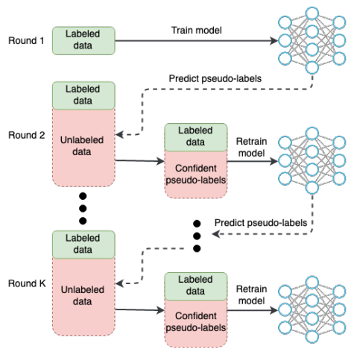
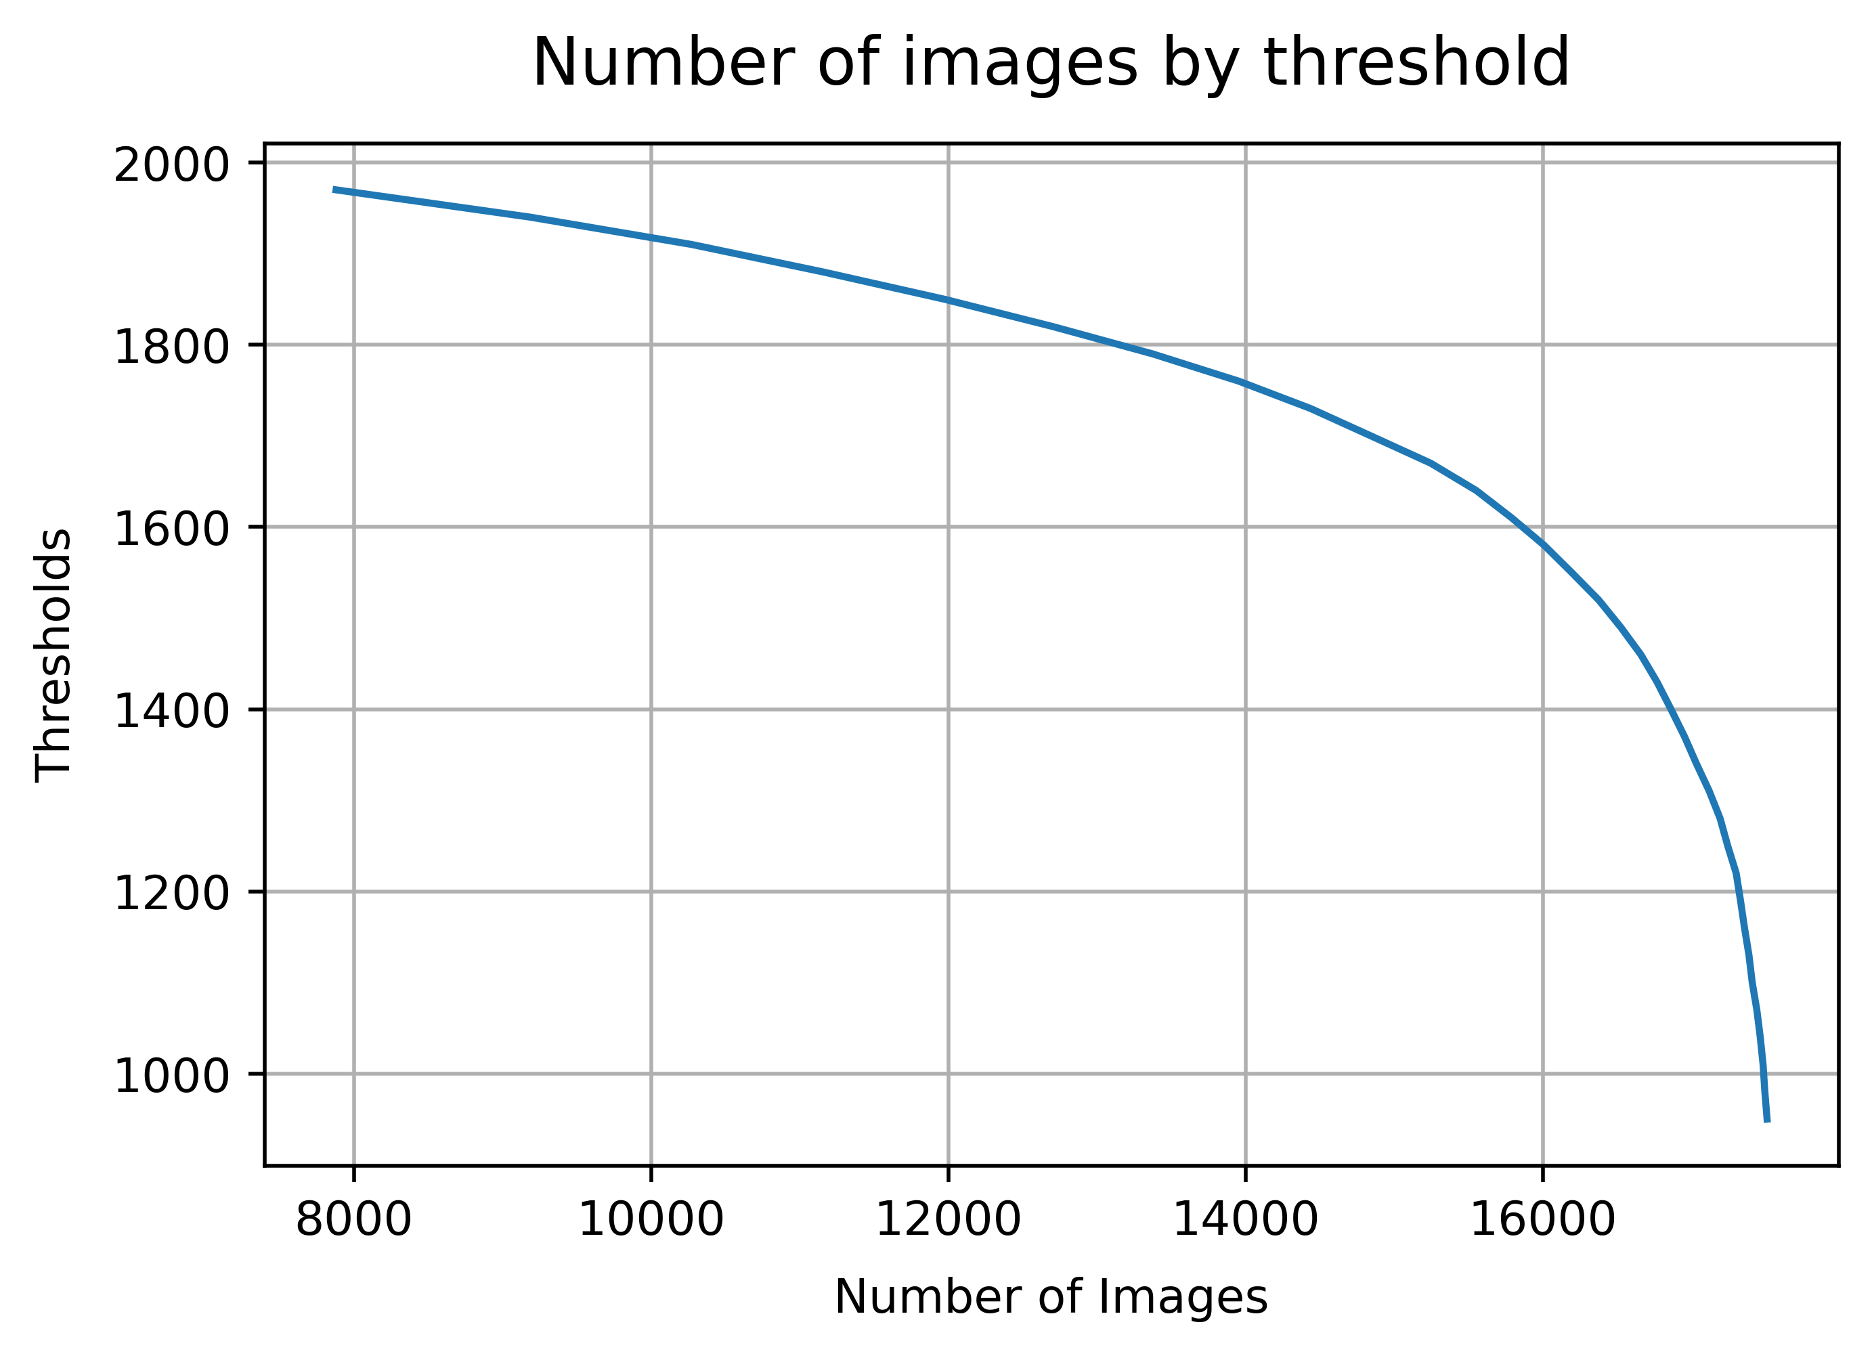
Semi-supervised Learning
Semi-supervised learning is a learning problem that involves a small number of labeled examples and a large number of unlabeled examples.
Learning problems of this type is challenging, since supervised learning algorithms aren’t able enough to make effective use of the mixtures of labeled and not labeled data. Thus, specialized semi-supervised learning algorithms are required.
Since the TGS dataset includes 4000 labeled images (train+validation dataset) and 18000 unlabeled (test dataset), we can consider to apply a semi-supervised learning approach to have more reliable scores.
In the picture on the upper right corner, it can be observed how a 3-round semi-supervised learning algorithm has been implemented for this task.
Moreover, for the next rounds it was calculated a confidence score for each image in the test dataset, using a binary cross-entropy.
On the bottom right corner, it can be observed the number of images that are above this confidence score.
Then, different thresholds were picked, and only the images above these thresholds were used for the second and third stage.
Finally, it has been observed that the best approach was taking all the images of the test dataset for the successive steps, without considering a threshold.
Fig 20. Semi-Supervised Learning procedure. Yauhen Babakhin, Artsiom Sanakoyeu, and Hirotoshi Kitamura. Semi-Supervised Segmentation of Salt Bodies in Seismic Images using an Ensemble of Convolutional Neural Networks. Aug 2019.
Fig 21. Curve of number of images above a certain confidence score

Slide 18
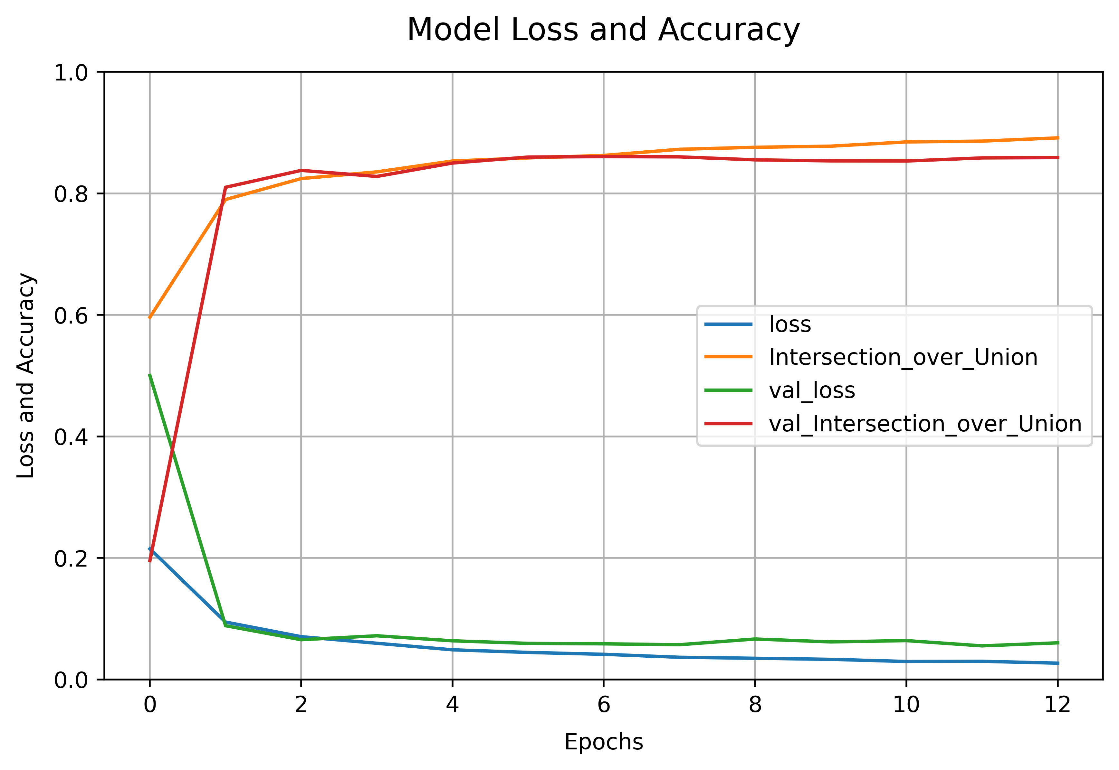
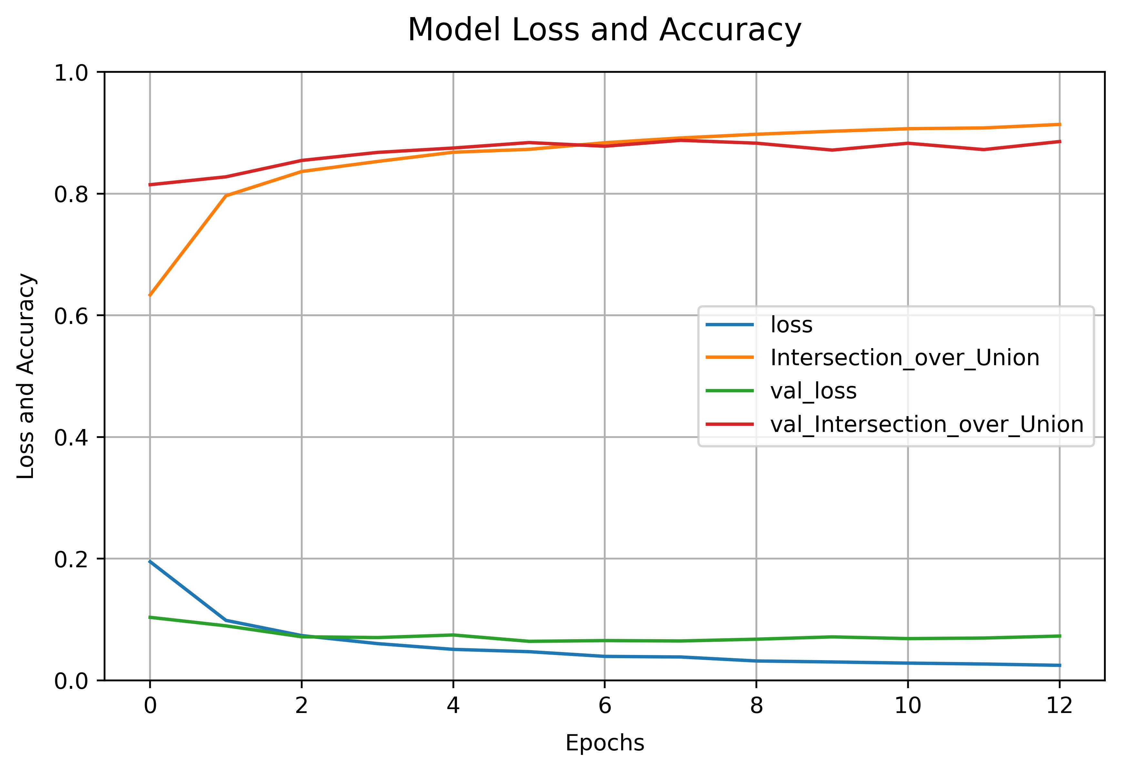
Loss and accuracy with semi-supervised learning and ensemble approach
II stage
III stage
Fig 22. Scores on train and validation dataset of an ensemble Unet+Resnet34 models after the second stage of a semi-supervised learning approach.
Fig 23. Scores on train and validation dataset of an ensemble Unet+Resnet34 models after the third stage of a semi-supervised learning approach.

Slide 19
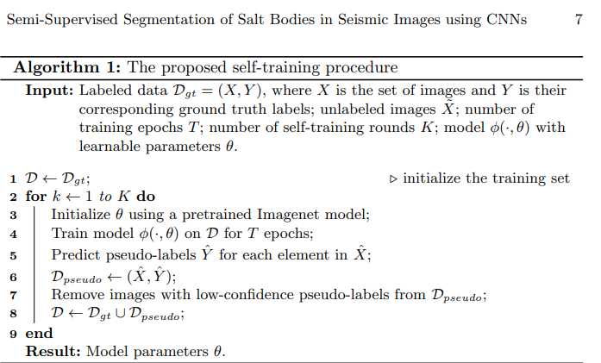
Training Pipeline
Fig 24. Algorithm of the Semi-Supervised learning steps. Yauhen Babakhin, Artsiom Sanakoyeu, and Hirotoshi Kitamura. Semi-Supervised Segmentation of Salt Bodies in Seismic Images using an Ensemble of Convolutional Neural Networks. Aug 2019.

Slide 20
Training Pipeline
I STAGE
II STAGE
III STAGE
Train Dataset
Predicted pseudo-labels
Predicted pseudo-labels
15 Unets
Concatenate
Concatenate
IoU threshold (>0.65)
4 Unets model
2 Unets model
8 Unets-50
+
Ensemble
+
Ensemble
Final Score
Final predictions

Slide 21
Results
Submission | Score | Description
15 | 0.81355 | Ensemble of #13 and 2 #14
14 | 0.81288 | Ensemble of #13 and 1 third stage Semi-Supervised learning model
13 | 0.80909 | Ensemble of #6 and 5 #7 models
12 | 0.80892 | Ensemble of #6 and 4 #7 models
11 | 0.80615 | Ensemble of #6 and 2 #7 models
10 | 0.80385 | Ensemble of #6 and 2 #7 models (one with Lovasz loss and binary cross-entropy)
9 | 0.80527 | Ensemble of #6 and 2 #7 models
8 | 0.80484 | Ensemble of #6 and #7
7 | 0.80311 | Second stage Semi-Supervised learning on ensemble of 8 Unet-50
6 | 0.79432 | Augmented data, ensemble of 8 Unet-50
5 | 0.78234 | Second stage Semi-Supervised learning on submission #3 (1250 threshold)
4 | 0.78041 | Second stage Semi-Supervised learning on submission #3 (1750 confidence score)
3 | 0.78562 | Unet-50 with augmented data
2 | 0.74327 | Unet-50
1 | 0.66790 | CNN
Fig 25. IoU scores on test dataset of all the submissions.

Slide 22
Results
Fig 25. Input test dataset seismic sections and their respective predicted output masks, obtained using the model with the highest IoU score. It can be clearly noticeable how the model can localize and detect the salt bodies (in yellow in the predicted output labels) where they are present.

Slide 23
How to further improve the model
Different loss functions.
Different learning schedules (i.e. cosine annealing).
Spending more time tuning the model.
Stack more models to the ensemble.
Add different models with complex architectures (to increase robustness and accuracy).
Try different cross-validation methods (k-fold, nested, stratified k-fold, etc.).
Use a more powerful GPU or a GPU cluster to reduce the training time and training more models.
Tune the model with different hyperparameters.

Slide 24
Conclusions
The process of manually labelling and delimiting salt bodies in thousands of images can be automated in the future with the use of CNNs.
The ensemble of the first, second, and third stage models was the model with the highest IoU score on the test dataset. Hence, ensemble is key to obtain more robust and accurate models.
Semi-Supervised Learning is a powerful technique which is very useful for this task, since we have a vast array of unlabeled images and few labeled images.
Local minima might be frequent for complex models, thus it is important to monitor the accuracy, and choose the model with the lowest loss and highest accuracy.

Slide 25
Thank you for your
attention!
Contacts:
Email: d.farchione@studenti.unipi.it
GitHub: https://github.com/Iron486/Salt-Body-Segmentation
Kaggle: https://www.kaggle.com/die9origephit/datasets

